Slide 1


DEM – Session 4
Mobile Design

Slide 2
Agenda
A word on design
A process for mobile design
Case study

Slide 3
A word on design

Slide 4
What is design thinking?
Purposive
Human Centered
Balance of analytical & creative
Iterative
Source: Coursera Gamification class by @kwerback
And: http://www.fastcompany.com/1139331/ideos-david-kelley-design-thinking

Slide 5
Mobile design
Mobile Design != Photoshop

Slide 6
Mobile Design Goals
An application that is
Easy to use the first time
Features make themselves available when needed
Looks good

Slide 7
User-centric
Mobile users are different than web/desktop
Frequent and small uses
Limited attention
Expect 0 learning curve
So your apps need to …
Start really quickly
Focus on what’s important
Make the main use-cases really easy

Slide 8
Mobile Design Basics
Use – Use – Use
You can’t design good mobile apps if you are not yourself a heavy user!
Pay attention
What happens the first time the app is started?
How did I realize that I could do this?
Where are the animations? What are their purpose?

Slide 9
Exercise
What is the best-designed application according to you?
Explain why

Slide 10
A process for mobile design

Slide 11
A three steps process for User Interface design
Identify the features of your apps
Sort the features by importance
Design the UX around the features

Slide 12
Identify the use-cases of your app
Brainstorm with all the project members
Who are your users?
Why do they launch the app?
Where are they when they launch the app?
What do they expect from the app?
List all the use-cases
Write them as a little sentence
Eg: The user is walking in the street, looking for directions to his next meeting.

Slide 13
Sort your use-cases by order of importance
First order use-cases
This is why 80% of users start your app
There should be only one – or two at most
Second order use-cases
Those are important use-cases that most user will need at some point
There may be a bunch of those
Third order use-cases
“Nice-to-have” use-cases
Those are use-cases that will make the user’s life easier but are not required

Slide 14
First order use-case
Google Maps
Search for an address
Facebook
Check out my newsfeed
Evernote
Read my notes
Write a new note
Interactions
Available immediately
0 or 1 click
Design
Hugely visible at startup

Slide 15
Second order use-cases
Google Maps
Itinerary
Where am I?
Facebook
Post an update
Send messages
Evernote
Search old notes
Add pictures/voice to note
Interactions
Two or more clicks
Design
Visible but not large

Slide 16
Third order use-cases
Google Maps
Compare itineraries
Help
Facebook
Add a new friend
Organize Groups
Evernote
Delete a note
Interaction
Hidden use-cases often require « secret » interaction to access
Design
Not visible in the interface

Slide 17
Design the user-experience
Based on the features you have identified
Choose a navigation pattern
Add user-interface elements to your app
Iterate until you have included all the features

Slide 18
Tools
Papers and pens are usually the best way to start
Divide and conquer
User-interface design
Paper - Powerpoint – Mockup tools
Graphic design
Photoshop (vector)

Slide 19
Exercise
Take one of your favorite mobile app
Identify the features of each group
First group
Second group
Third group
How are they represented in the UI?

Slide 20

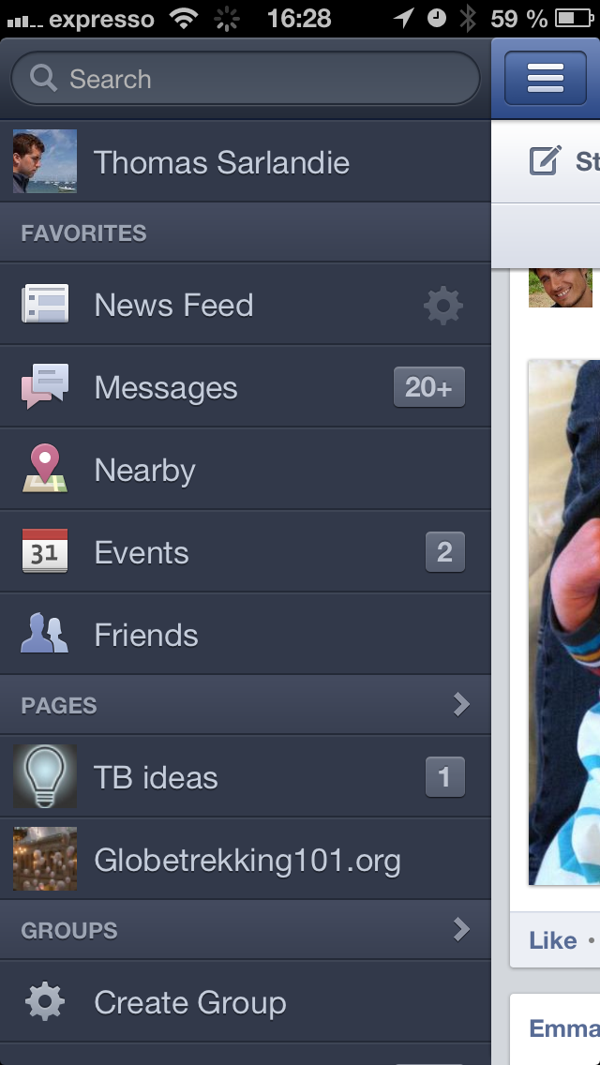
Facebook

Slide 21
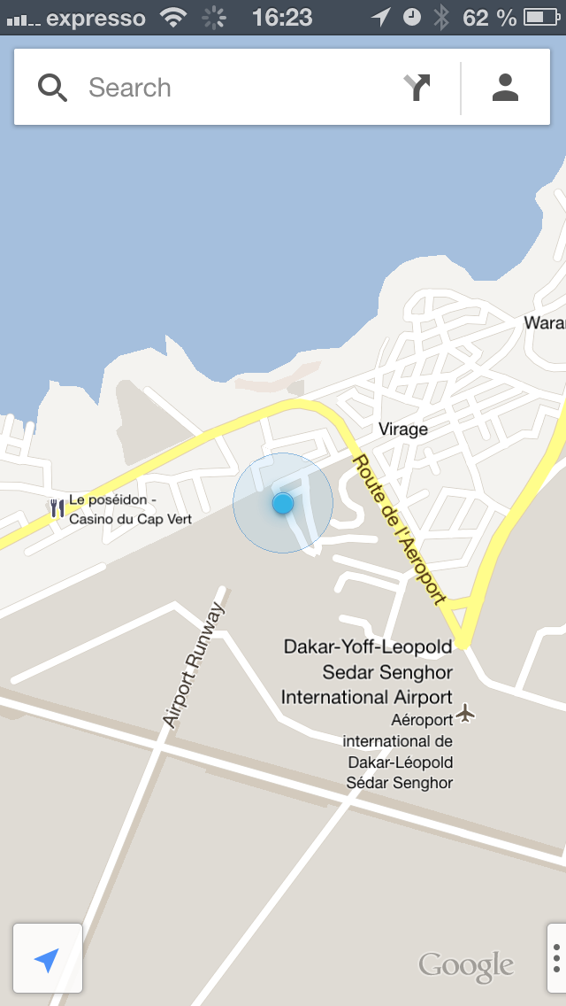
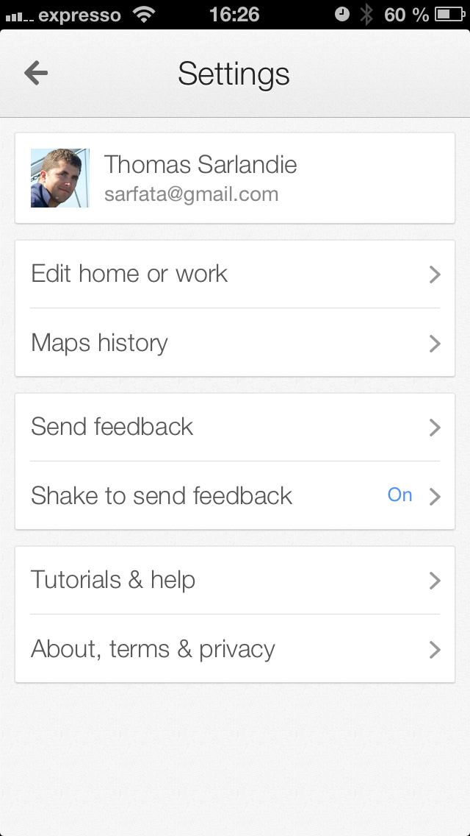
Google Maps

Slide 22
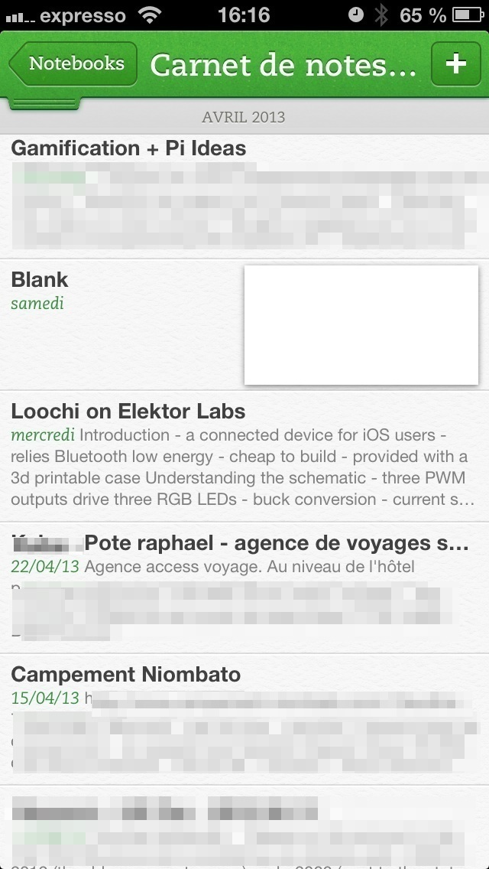
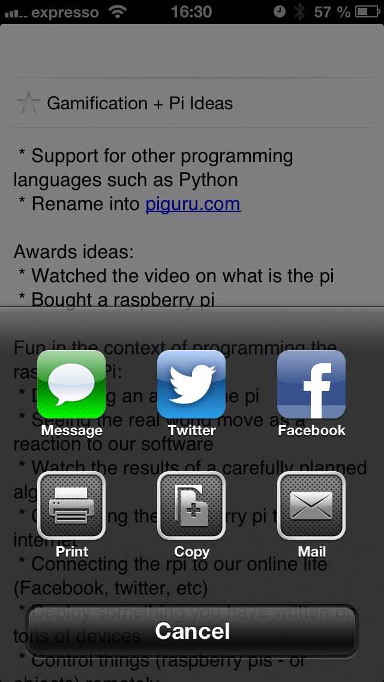
Evernote

Slide 23
Mobile user interface

Slide 24
Mobile User Interface
Is based on design patterns and metaphors
They help the users recognize what is going on
They help the developer reuse code
Read the holy books
iOS Human Interface Guidelines
https://developer.apple.com/library/ios/#documentation/UserExperience/Conceptual/MobileHIG/
Android
http://developer.android.com/design/index.html

Slide 25
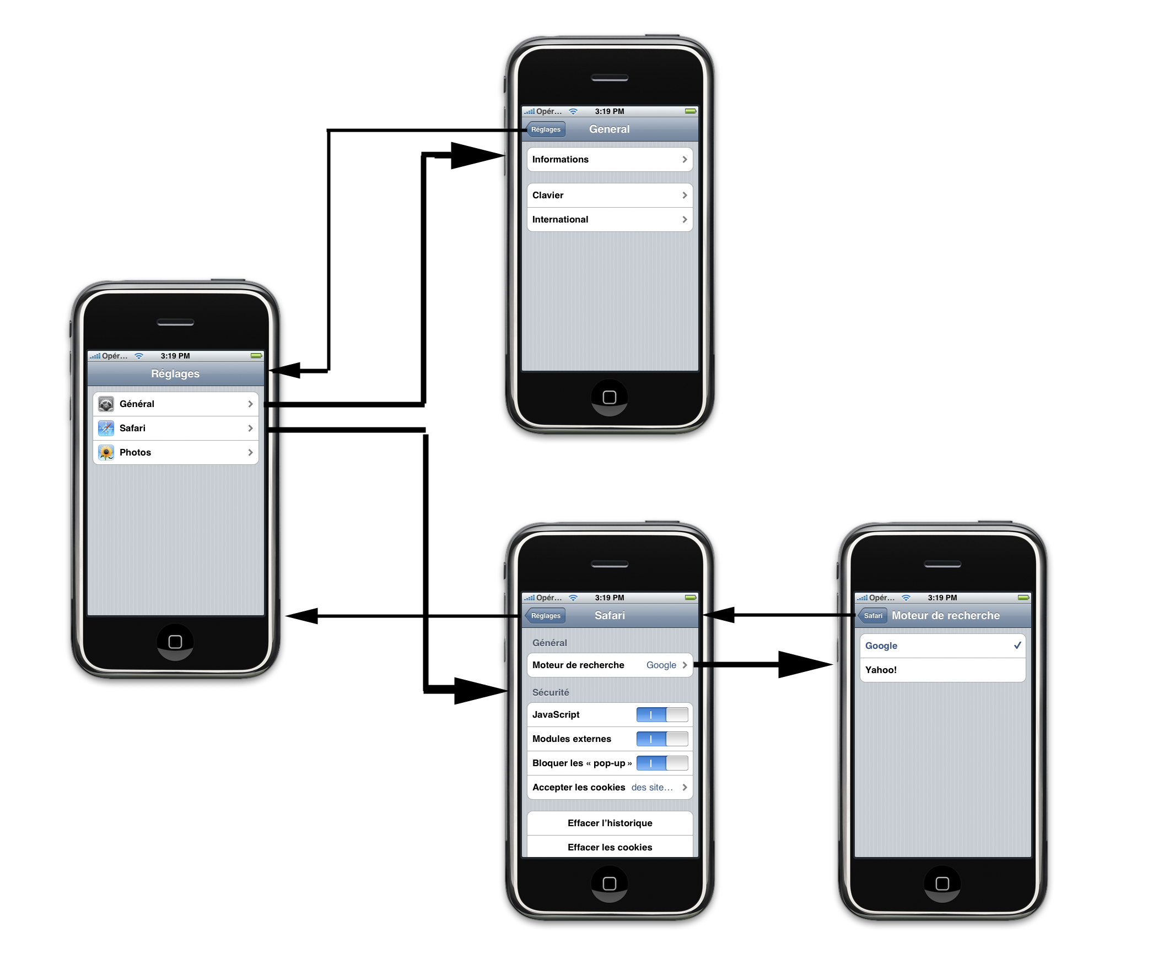
Mobile navigation patterns

Slide 26
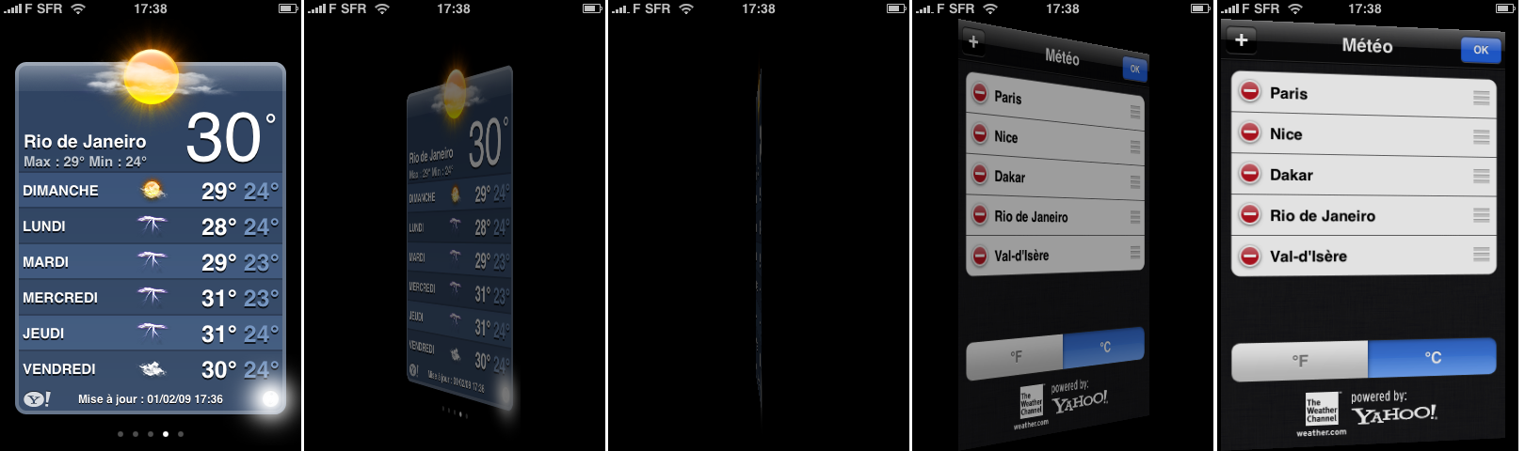
Mobile navigation patterns

Slide 27
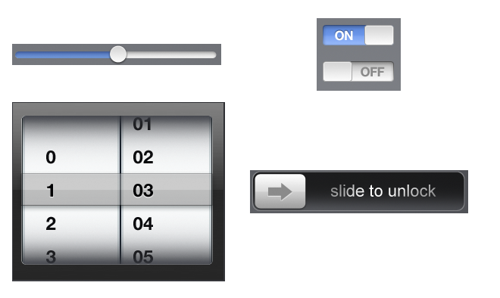
User interface Metaphors

Slide 28
Case Study

Slide 29
Case study
A train company wants to create a mobile device application with real-time information on departure (platform, time) and arrivals (platform, delay)

Slide 30
